Slide 1

Ceph is a unified, distributed storage system designed for excellent performance, reliability, and scalability
Ceph's design is based on the RADOS software which provides the ability to build a distributed storage system without a single point of failure
Ceph's ability to handle vast amounts of data also makes it suitable for use in data-intensive applications like scientific data processing and media streaming

Slide 2
Introduction to Ceph Storage
Ceph, first developed by Sage Weil for his PhD dissertation in 2005, is a highly-resilient software-defined storage system that aims to provide high performance, reliability, and scalability
It uniquely decouples data and metadata operations, effectively handling their distribution across diverse storage devices independently
Ceph provides software-defined storage which efficiently operates on commodity hardware, making it cost-effective

Slide 3
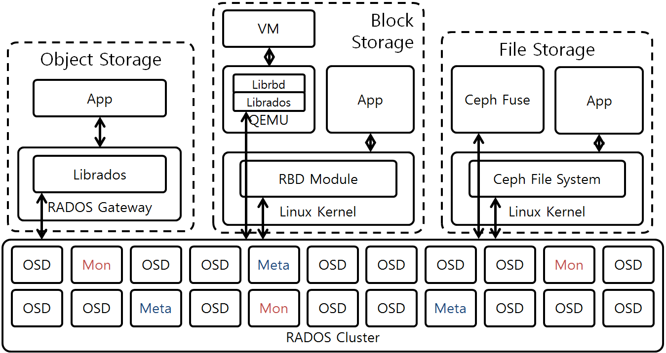
Ceph Architecture Overview
Ceph's architecture is designed to be fault-tolerant, auto-scalable, and self-healing
The Ceph architecture is based on the principle of decoupling data and metadata operations
The architecture also includes the use of the CRUSH algorithm, which enables Ceph to scale, rebalance, and recover automatically
This Photo by Unknown author is licensed under CC BY-SA-NC.

Slide 4

Ceph Architecture Overview Contd
A practical use case of Ceph's architecture is in a large-scale data center. For instance, a company with a large amount of customer data can use Ceph to store and manage this data. The company can start with a small deployment and as their data grows, they can add more storage nodes to the Ceph cluster. The data will be automatically rebalanced across the new nodes, and if any node fails, Ceph will automatically replicate its data to other nodes. This ensures that the data is always available and safe.

Slide 5
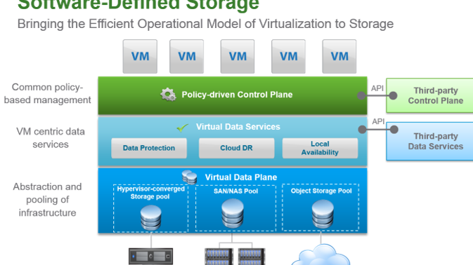

Slide 6
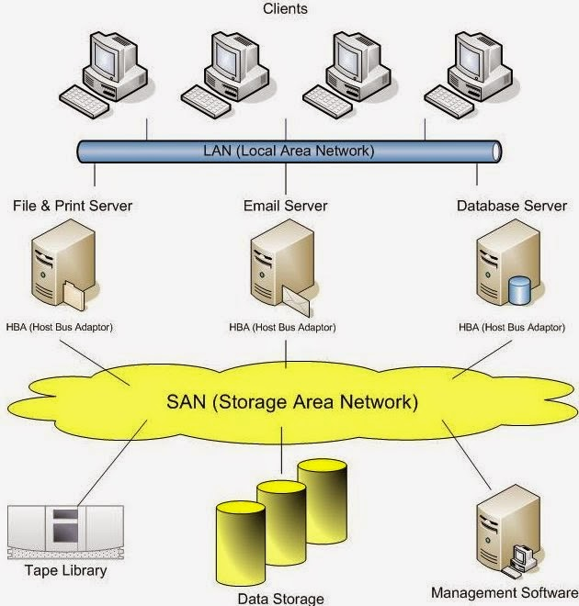
The Importance of Ceph
In today's digital age, data is king and managing vast amounts of it in a safe, scalable, and accessible manner is crucial
Its self-managing capabilities automate the tasks of data distribution, error detection, and repair, thereby reducing administrative overhead
It's also highly flexible and adaptable, supporting three types of storage interfaces: object, block, and file storage
This Photo by Unknown author is licensed under CC BY-NC-ND.

Slide 7
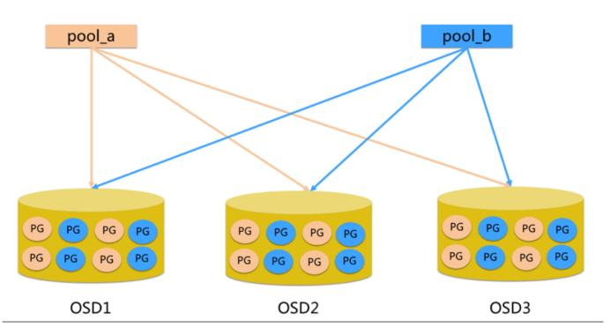
Understanding RADOS
At the heart of Ceph lies RADOS
It is the component that ensures the reliable storage and retrieval of data in a distributed network
RADOS is responsible for data replication, recovery from failures, and rebalancing of data distribution when new nodes are added or existing nodes are removed
This Photo by Unknown author is licensed under CC BY-SA.

Slide 8
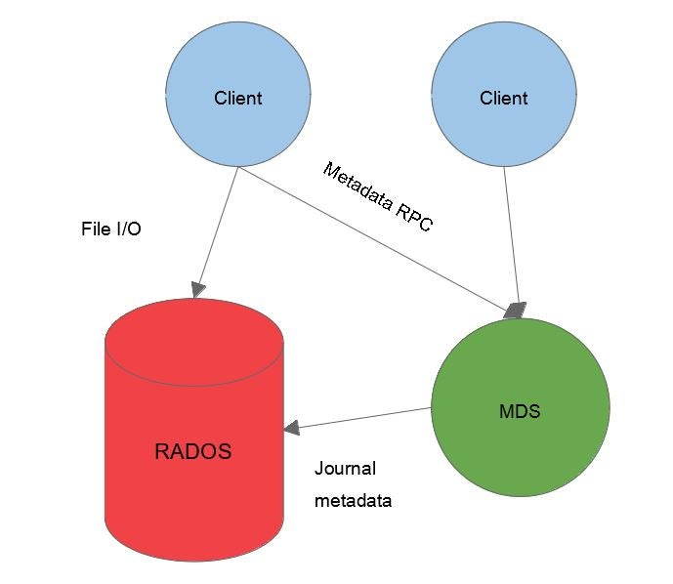
Role of RADOS in Ceph
RADOS provides the fundamental functionality that allows Ceph to create a fault-tolerant system
It manages storage nodes , handles data replication, recovery, and rebalancing
With its robust functionality, RADOS provides the software-defined storage environment upon which the rest of the Ceph architecture is built
This Photo by Unknown author is licensed under CC BY-SA.

Slide 9
Daemons of Ceph Storage
Ceph OSD Daemon:Ceph OSDs store data on behalf of Ceph clients. Additionally, Ceph OSDs utilize the CPU, memory and networking of Ceph nodes to perform data replication, erasure coding, rebalancing, recovery, monitoring and reporting functions.
Ceph Monitor: A Ceph Monitor maintains a master copy of the Red Hat Ceph Storage cluster map with the current state of the Red Hat Ceph Storage cluster. Monitors require high consistency, and use Paxos to ensure agreement about the state of the Red Hat Ceph Storage cluster
The Ceph Manager handles execution of many of the read-only Ceph CLI queries, such as placement group statistics. The Ceph Manager also provides the RESTful monitoring APIs

Slide 10
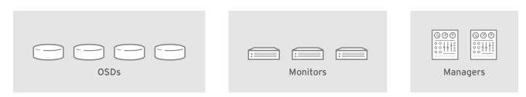
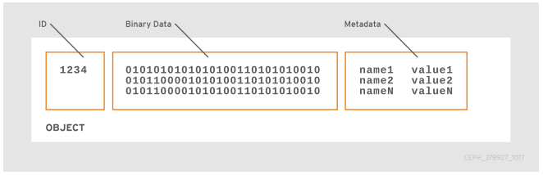

Slide 11
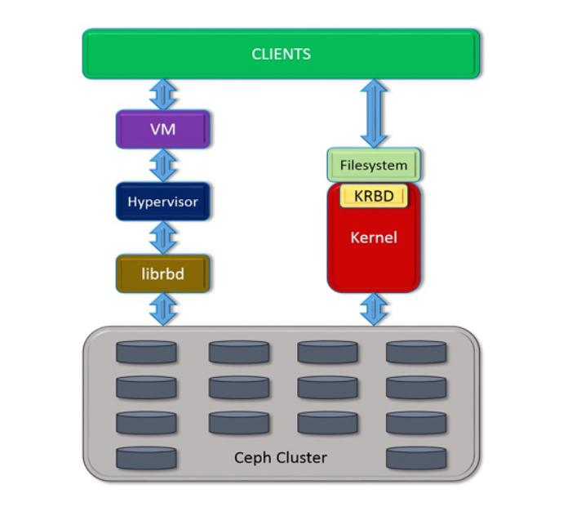
Understanding MON in Ceph
MON, or Monitor, nodes in Ceph maintain the master copy of the cluster map, which includes critical information like monitor map, manager map, OSD map, and the CRUSH map
These maps collectively represent the overall cluster state and configuration
Monitors play the critical task of preventing "split-brain" scenarios, a state of inconsistency due to a network partition in the cluster
This Photo by Unknown author is licensed under CC BY-SA.

Slide 12

Role of MON in Ceph
Monitors play a pivotal role in the Ceph cluster as they maintain the high availability and reliability of the network
They keep track of all the heartbeat messages of other nodes, making sure data is properly replicated and recovered in case of failures
They are also responsible for managing client sessions and providing the latest cluster map to clients

Slide 13
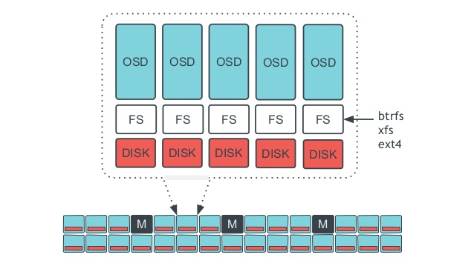
Understanding OSD in Ceph
Object Storage Daemons are the backbone of the Ceph storage system
They are responsible for storing data, replication, recovery, rebalancing of data distribution, and reporting back to monitor nodes
An OSD typically corresponds to a physical disk in the Ceph storage cluster

Slide 14
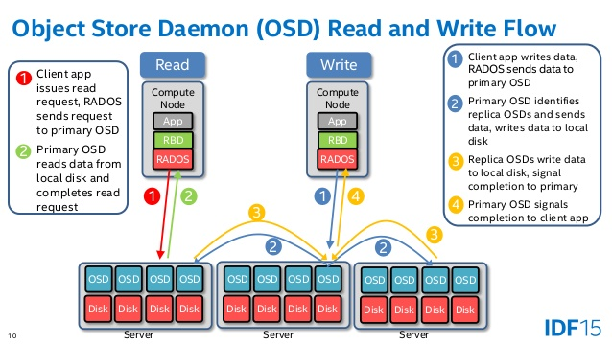
Role of OSD in Ceph
Each OSD daemon corresponds to a physical disk in the storage cluster
In the event of a failure, OSDs can self-report and re-balance the data distribution in the cluster
They also manage object replication, recovery, backfilling, rebalancing, and provide crucial data like hardware performance metrics to Monitor nodes

Slide 15
Ceph Architecture Overview
Ceph's architecture is constructed to be fault-tolerant, auto-scalable and self-healing
The architecture consists of clients that read and write data, Monitor nodes that keep track of all the active nodes, Metadata servers that store metadata for the Ceph File System, and Object Storage Devices that store the actual data
This Photo by Unknown author is licensed under CC BY-SA-NC.

Slide 16
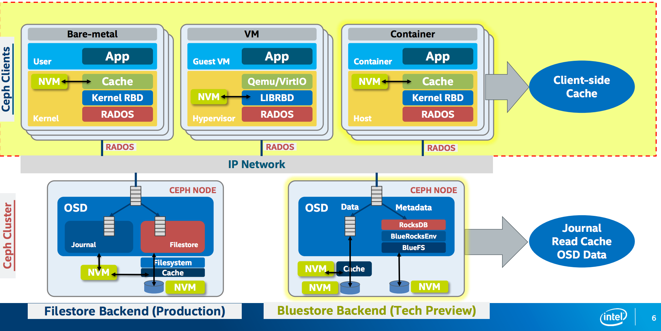
Ceph Clients
Ceph Clients are the users of the Ceph storage system
They do not have a centralized server or broker to handle their I/O operations, but instead, they use the CRUSH algorithm to independently compute where to read and write data
This allows clients to operate in parallel and enables the system to scale in a linear manner

Slide 17
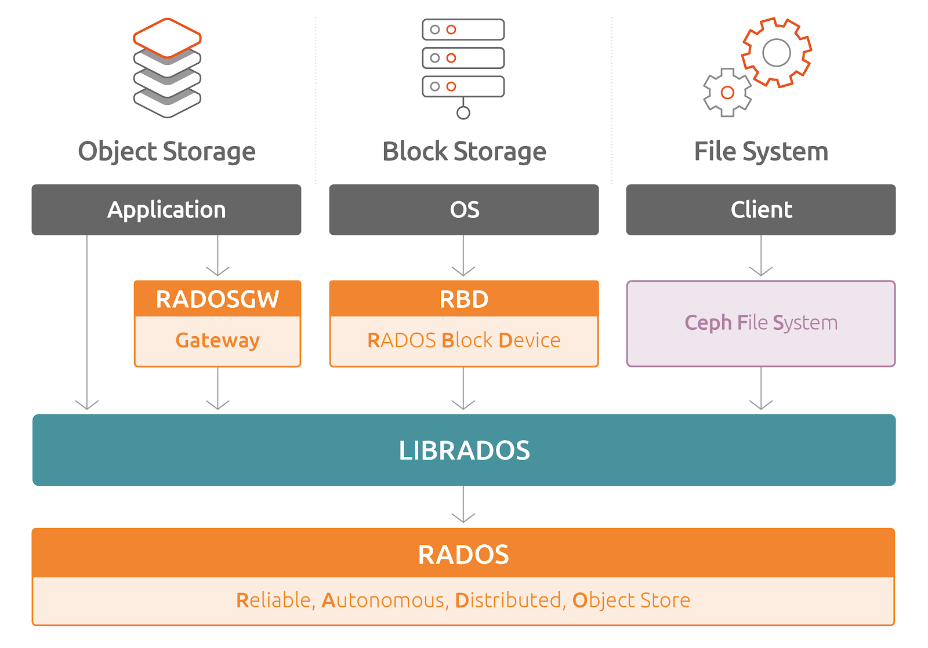
Ceph Block Storage
RADOS Block Device is a component of Ceph that allows it to interact with the storage system as if it were a physical block device while benefiting from the distributed features of the system
RBD interfaces with the Ceph storage cluster directly, offering a reliable and easy way to take snapshots and replicate data
It is often used in conjunction with QEMU, a hosted virtual machine monitor, to provide virtual machines with disk images stored in the Ceph cluster

Slide 18
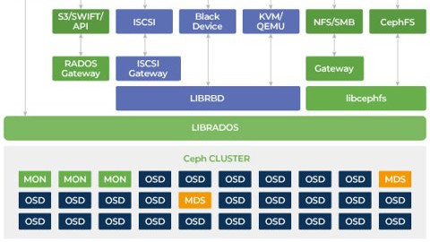

Slide 19
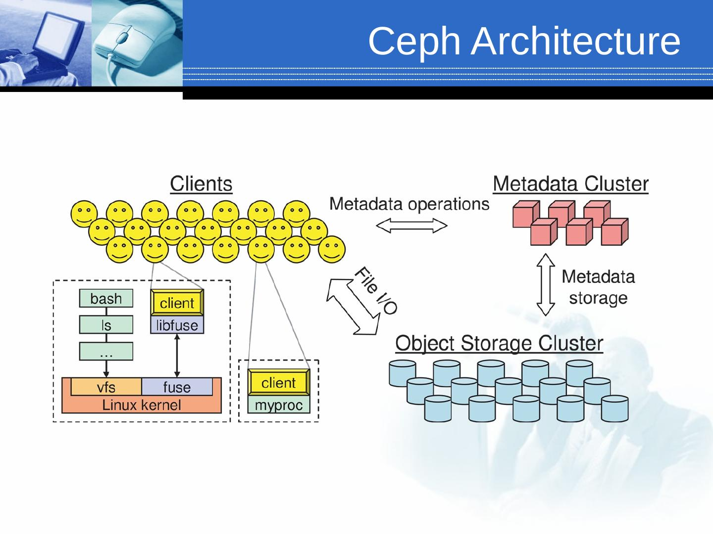
Ceph File System
The Ceph File System is a POSIX-compliant file system built on top of a Ceph Storage Cluster
Unlike conventional file systems that may rely on a single server, Ceph FS uses the Ceph Storage Cluster to store data, making it fault-tolerant and eliminating a single point of failure
Moreover, Ceph FS allows for multiple interfaces to the same data and offers a higher degree of compatibility and flexibility than traditional file systems

Slide 20
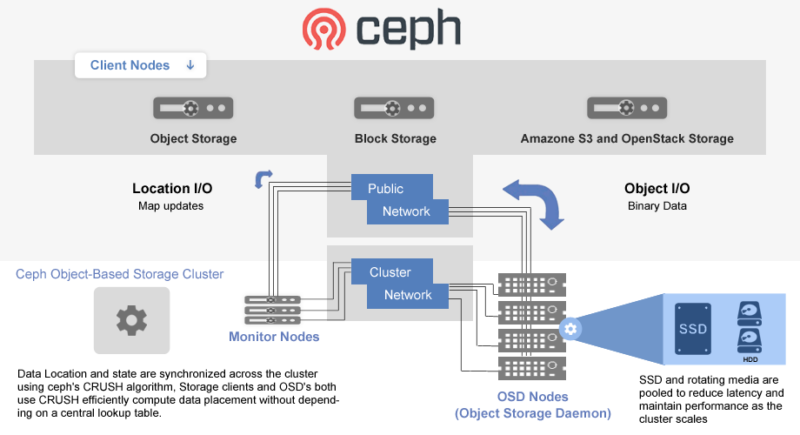
Ceph Object Storage
The RADOS Gateway is an object storage interface built on top of librados to provide applications with a RESTful gateway to Ceph Storage Clusters
It also provides an S3 and Swift compatible API for seamless integration with existing applications, services, and tools
The RADOS Gateway separates the namespace from the underlying storage layer, which enables it to scale horizontally and independently

Slide 21
CRUSH Algorithm
CRUSH, short for Controlled Replication Under Scalable Hashing, is an algorithm that Ceph uses to determine how to store and retrieve data by computing data storage locations
Unlike traditional methods that require centralized brokers or mapping tables to determine where data is stored, CRUSH empowers Ceph to scale, rebalance, and recover automatically, all while minimizing the need for manual administrative intervention

Slide 22
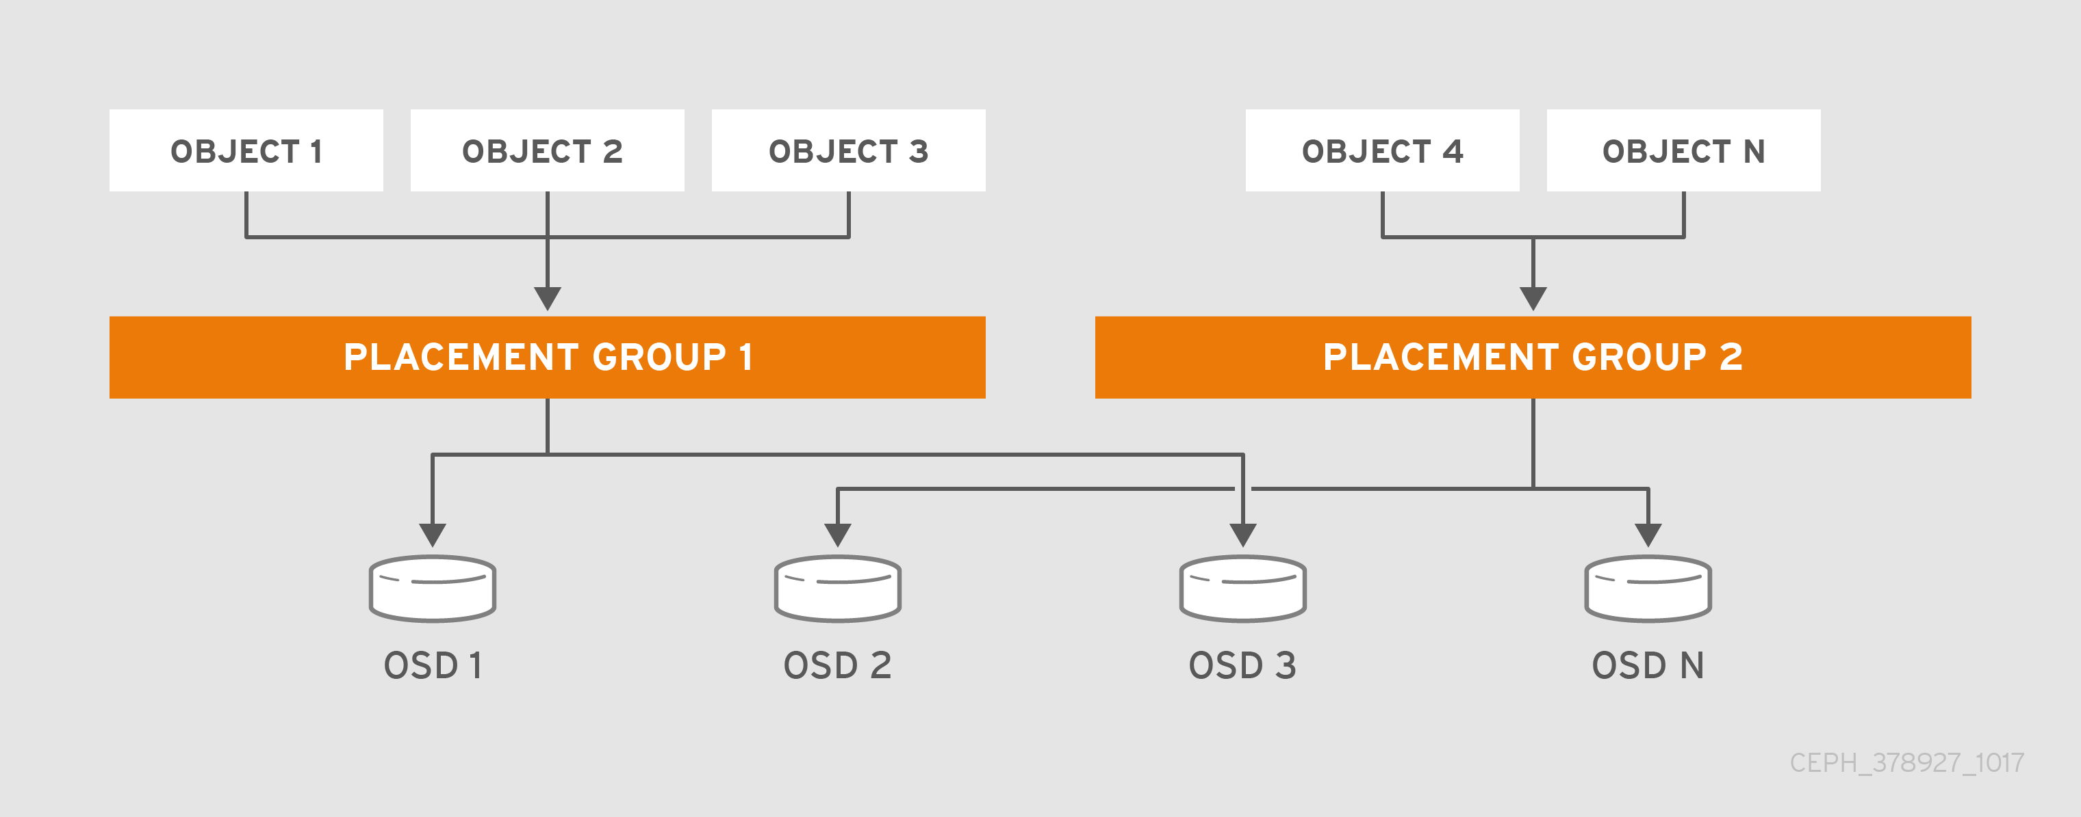
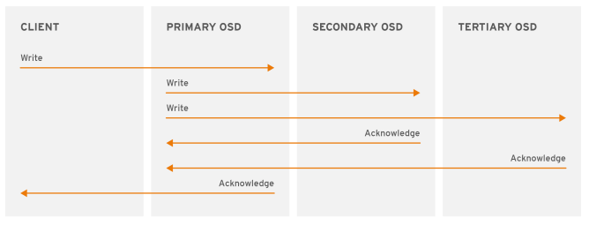

Slide 23
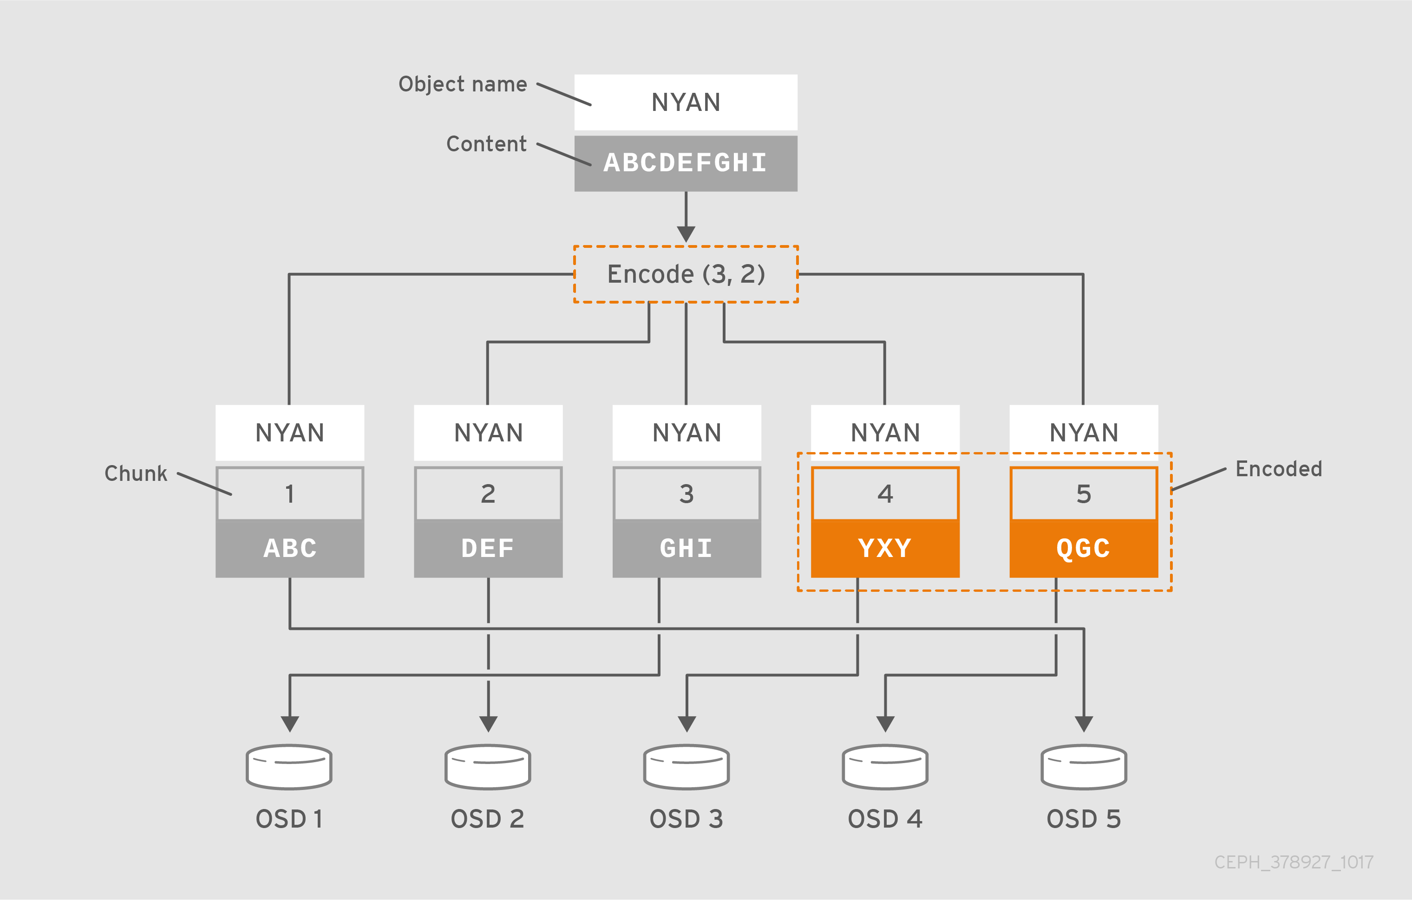

Slide 24
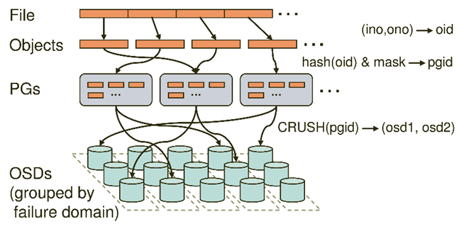
Ceph Pool
A Ceph Pool is a logical partition for storing objects
It abstracts the details of underlying storage and provides a simplified model for managing data
A pool can either be replicated or erasure coded, which allows for a flexible approach to balancing data redundancy, resilience, and storage efficiency

Slide 25
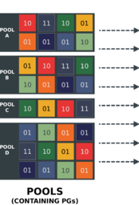
Ceph pools define
Pool Type: In early versions of Ceph, a pool simply maintained multiple deep copies of an object
Ceph can maintain multiple copies of an object, or it can use erasure coding to ensure durability
The data durability method is pool-wide, and does not change after creating the pool
Ceph must handle many types of operations, including data durability via replicas or erasure code chunks, data integrity by scrubbing or CRC checks, replication, CHAPTER
Ceph addresses this bottleneck by sharding a pool into placement groups

Slide 26
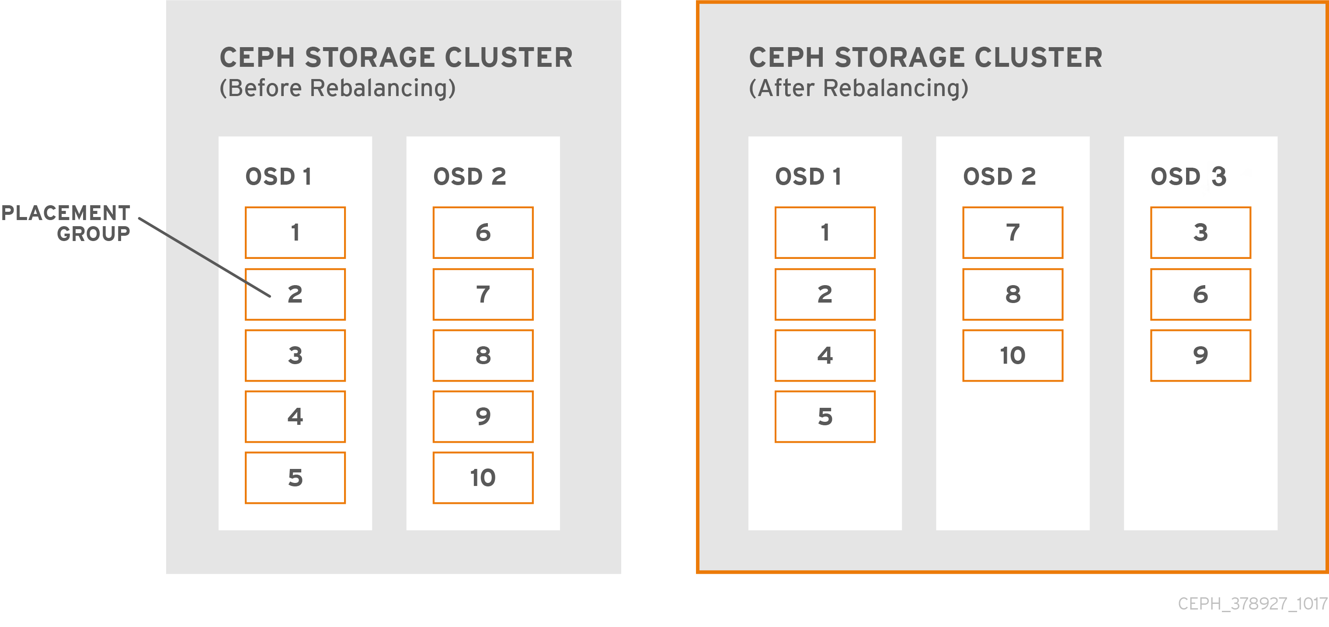

Slide 27
Ceph Replicated Pools
Replicated pools are a type of pool in Ceph where multiple copies of an object are stored in different OSDs
This strategy is simple and provides the highest level of data safety
The number of copies can be defined during pool creation and provides a simple way to increase the redundancy of data

Slide 28
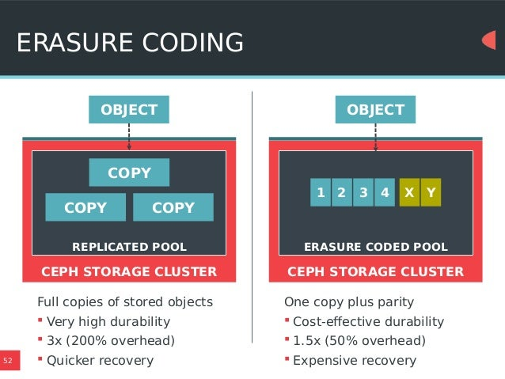
Ceph Erasure Coded Pools
Erasure coded pools are a space-efficient alternative to replicated pools
They divide the data into smaller chunks, calculate parity chunks, and then distribute them across different OSDs
In the event of data loss, erasure coding

Slide 29
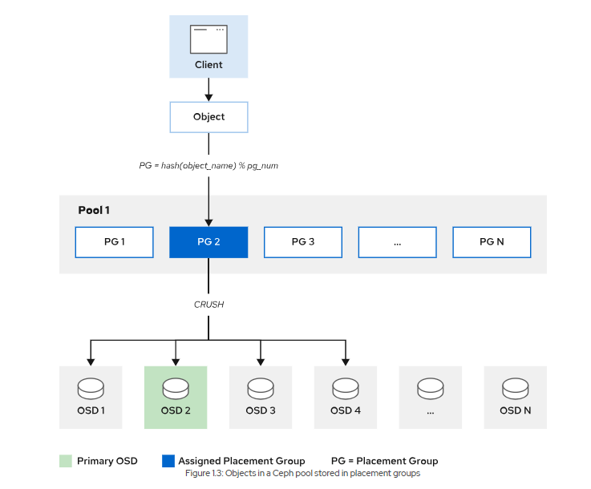

Slide 30
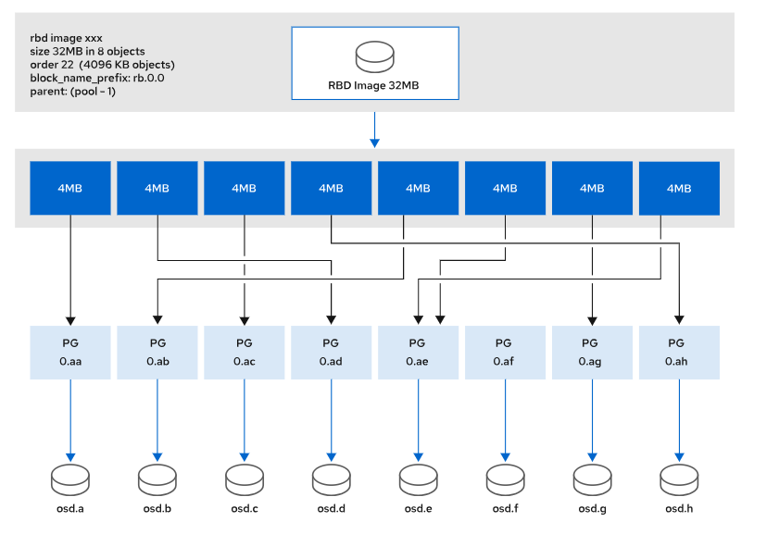

Slide 31
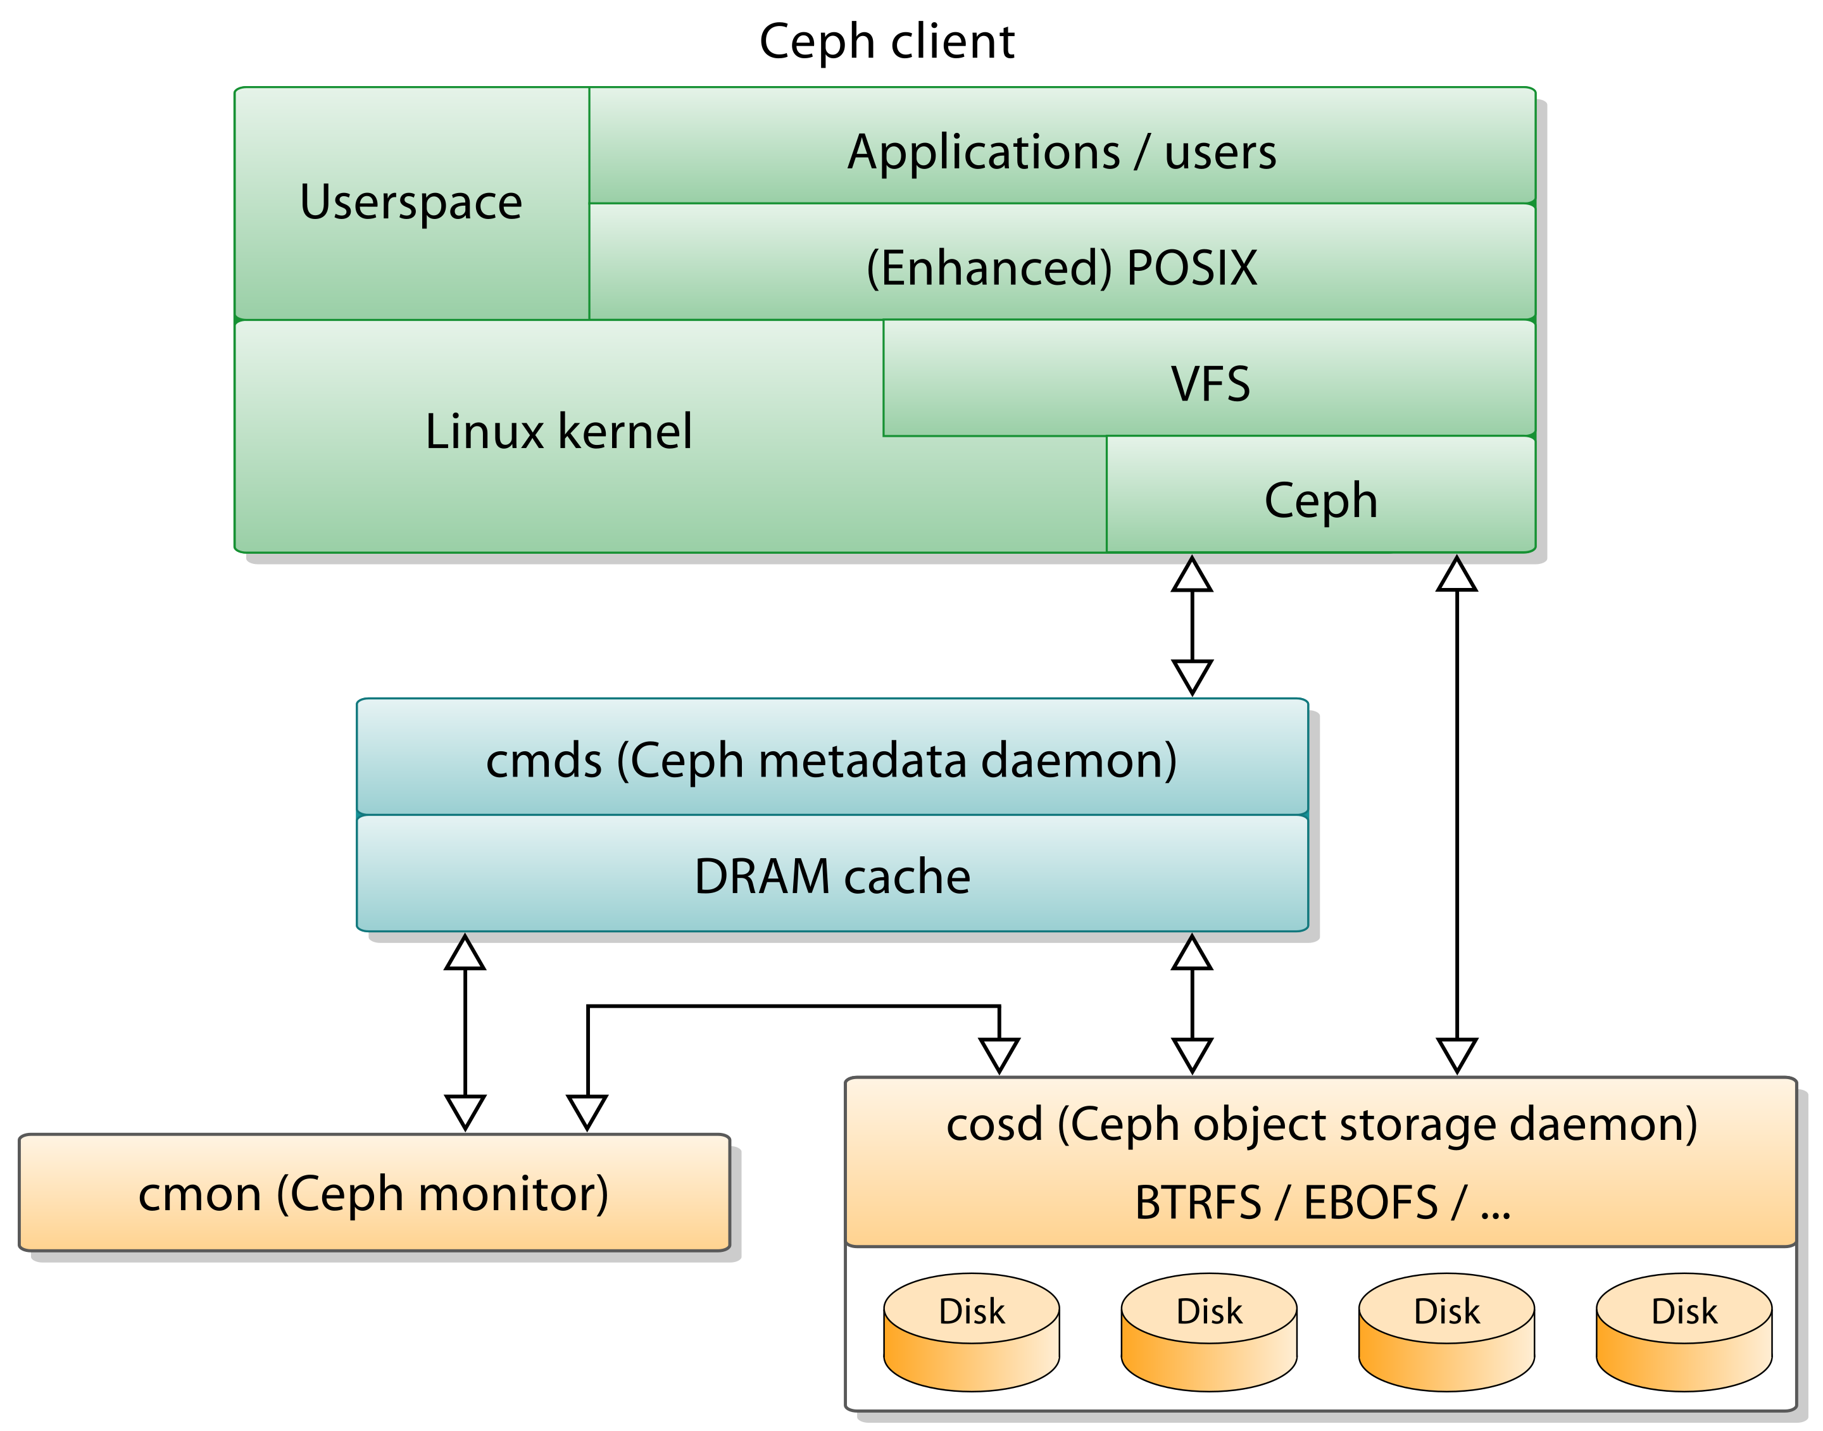
Ceph Configuration
Ceph configuration is facilitated through the ceph.conf file
This is where settings for monitors, OSDs, and metadata servers are specified
Critical configurations include public and cluster network, monitor hosts, log files, OSD journal size, and filestore options

Slide 32
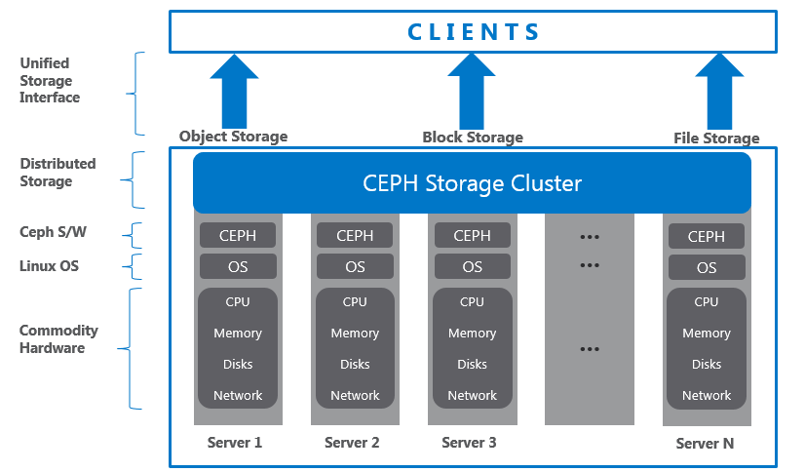
Ceph Performance Tuning
Performance tuning in Ceph involves multiple facets
Hardware tuning may include the use of SSDs for OSD journals, adequate CPU and memory resources, and 10GbE or higher network connections
Within the Ceph configuration, adjusting parameters like osd_op_threads, filestore_op_threads, and the cache size can impact performance

Slide 33
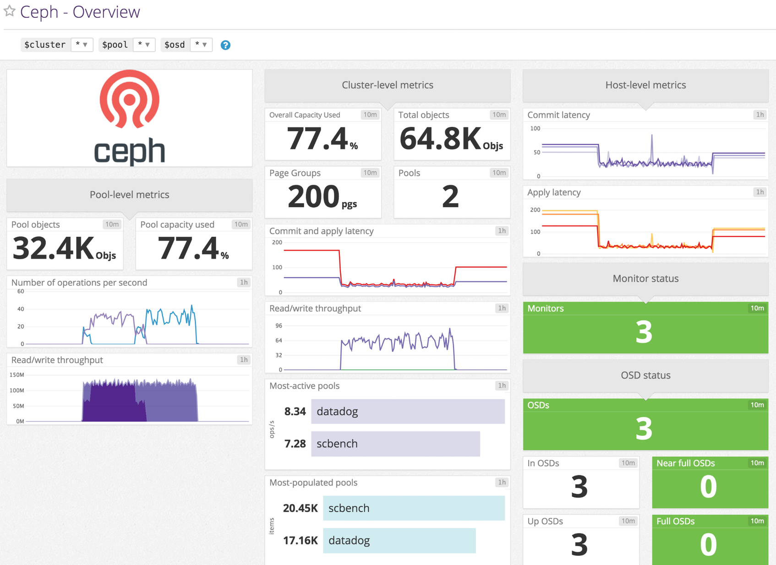
Ceph Monitoring
Monitoring a Ceph cluster is key for its health
The built-in Ceph Dashboard provides a visual interface to check cluster status, performance metrics, and capacity usage
For deeper insights, Prometheus integrated with Grafana can help visualize key metrics like throughput, latency, and IOPS, along with the status of OSDs and pools

Slide 34
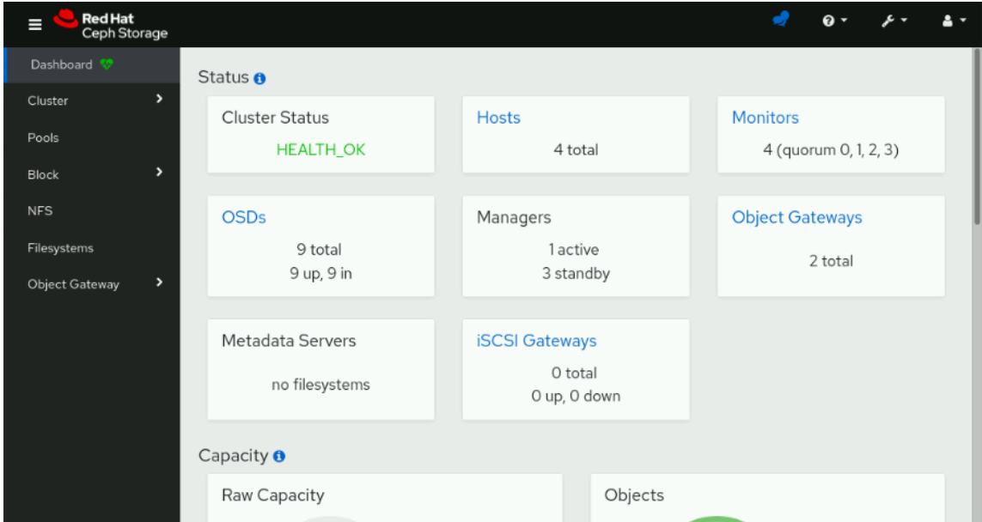

Slide 35
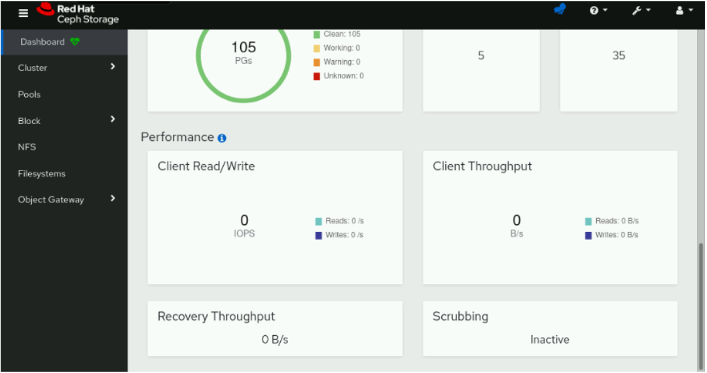

Slide 36
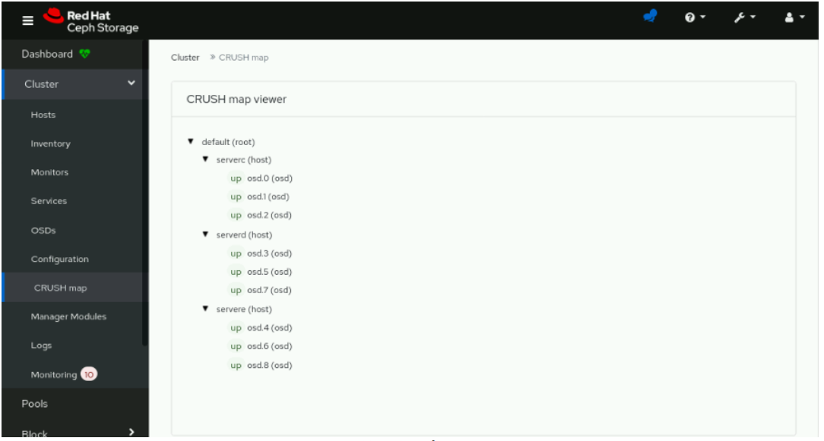

Slide 37
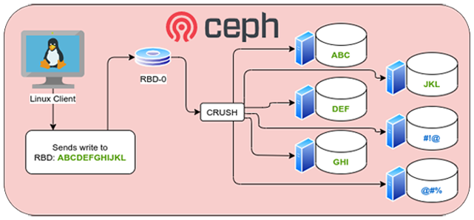
Ceph Troubleshooting
When encountering issues with Ceph, start by checking the cluster health status with "ceph health" command
Checking for hardware issues, such as failed disks or network issues, is also important
Finally, the Ceph user and developer communities can be invaluable resources for troubleshooting

Slide 38
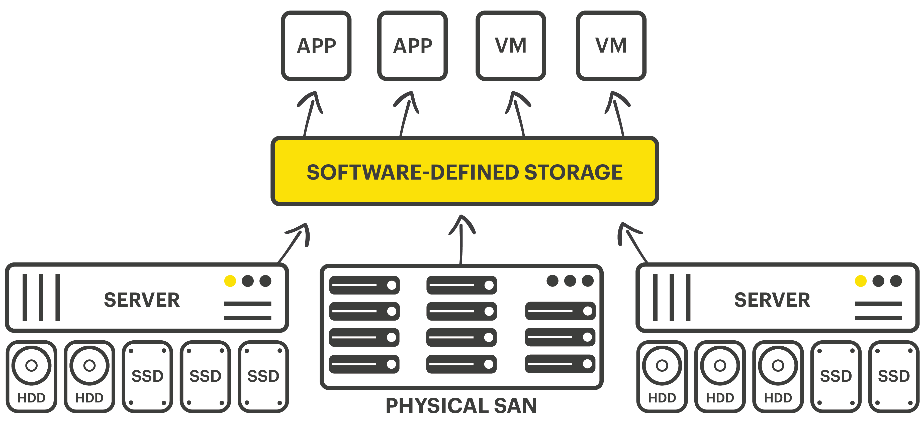
Ceph Use Cases
Cloud services use it for providing scalable storage
Data analytics platforms leverage it for storing large data sets
Media streaming services appreciate its ability to handle high-throughput workloads

Slide 39
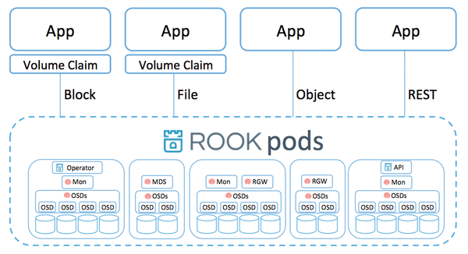
Ceph and Kubernetes
Ceph and Kubernetes make a powerful combination
With the help of Rook, a cloud-native storage orchestrator, Ceph can be used to provide persistent storage for Kubernetes applications
Rook handles the deployment and scaling of the storage, while Ceph ensures data resiliency and performance

Slide 40
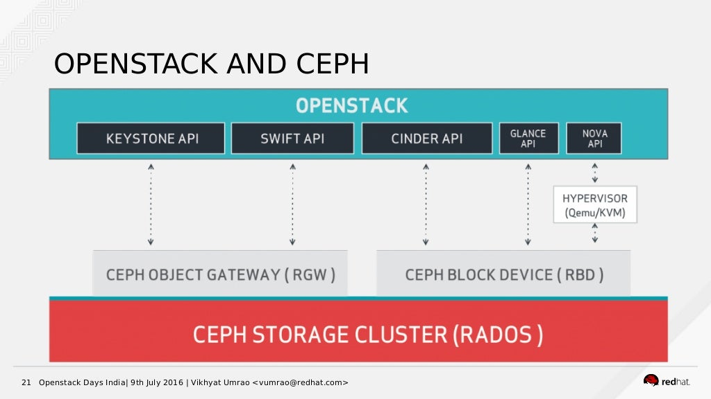
Ceph and OpenStack
Ceph is a popular choice for OpenStack storage
It integrates with OpenStack components like Cinder for block storage, Glance for image storage, and Nova for ephemeral storage, making it a comprehensive storage solution
Its scalability and resilience align well with the needs of OpenStack deployments

Slide 41

Ceph Future Developments
Future developments in Ceph aim to continue improving its performance, scalability, and ease of use
These include enabling erasure coding with RBD and CephFS, enhancing the bucket index in RADOS Gateway for better scalability, and further development on Crimson, a new OSD backend aimed at faster hardware and reduced CPU usage
This Photo by Unknown author is licensed under CC BY-SA.

Slide 42
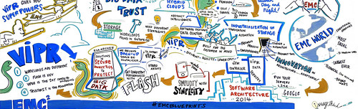
Conclusion
As a robust, flexible, and highly scalable storage solution, Ceph is a compelling choice for many organizations
Its architecture and features facilitate various applications, including cloud services, data analytics, and more
It offers a versatile platform that can adapt to changing storage needs
This Photo by Unknown author is licensed under CC BY-SA.

Slide 43

References
To dive deeper into Ceph, consider visiting the official Ceph documentation for detailed information on its architecture, components, and usage
The Ceph GitHub repository contains the source code, and you can follow ongoing development there
For community support, the Ceph community mailing list is an active platform for discussions and troubleshooting

Slide 44
Thank You
Should you have any questions about Ceph, feel free to ask
Keep in mind that the vibrant Ceph community is always ready to help and support new members
Quiz Time

